Slide 1
Computer Programming
Functions

Slide 2
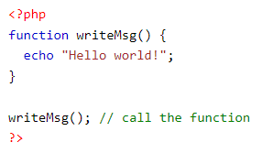
What is a function?
A function is simply a “chunk” of code that you can use over and over again, rather than writing it out multiple times.
A user-defined function declaration starts with the word function:
In the example above, we create a function named "writeMsg()". The opening curly brace ( { ) indicates the beginning of the function code, and the closing curly brace ( } ) indicates the end of the function. The function outputs "Hello world!". To call the function, just write its name followed by brackets ():

Slide 3
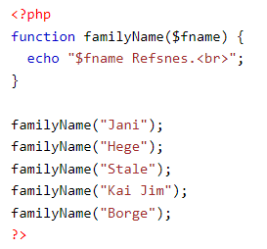
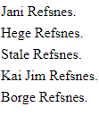
PHP Function Arguments
Information can be passed to functions through arguments. An argument is just like a variable.
Arguments are specified after the function name, inside the parentheses. You can add as many arguments as you want, just separate them with a comma.
The following example has a function with one argument ($fname). When the familyName() function is called, we also pass along a name (e.g. Jani), and the name is used inside the function, which outputs several different first names, but an equal last name:

Slide 4
PHP MySQLi Functions
The MySQLi functions allows you to access MySQL database servers.
mysqli_connect() function opens a new connection to the MySQL server.
mysqli_error() function returns the last error description for the most recent function call, if any.
mysqli_fetch_all() function fetches all result rows and returns the result-set as an associative array, a numeric array, or both.
mysqli_query() function performs a query against a database.
mysqli_fetch_assoc() function fetches a result row as an associative array.

